Slide 1
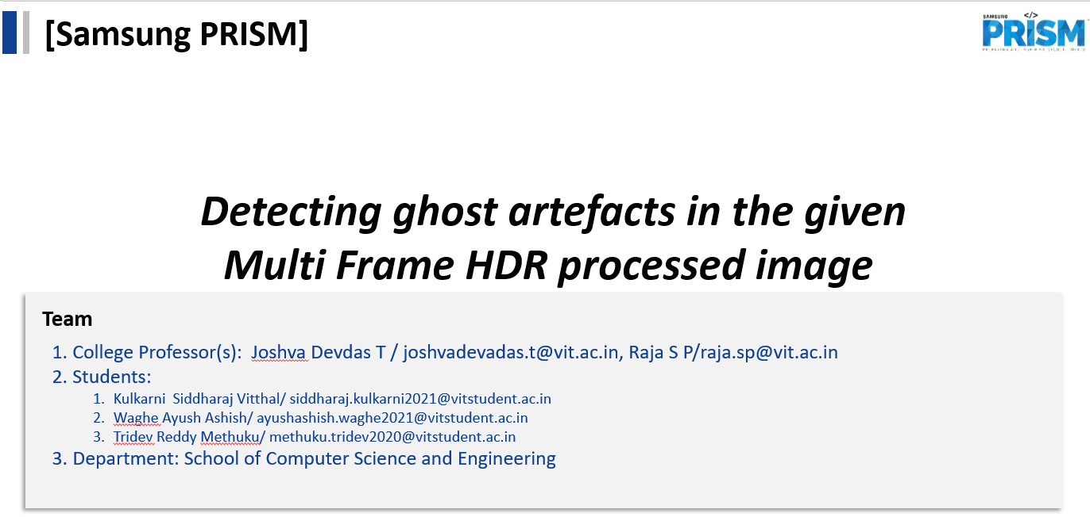
Date-:8th Jannuary 2023

Slide 2
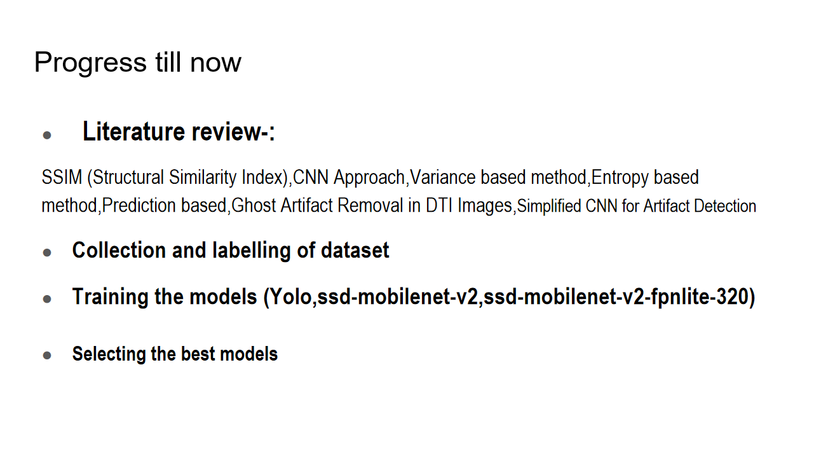

Slide 3
KPIs Achieved
Implemented different models, compared them to see which is the most effective one
Handled overfitting of the model
Generalised model for more objects
Validated the models with the test data
Finalized the model

Slide 4
Technical challenges
Limited number of resources-Google coolab
Used other alternatives like Kaggle and jupyter notebooks
Using multiple accounts
Compatibility issues of libraries on local machine and kaggle notebook
Some ghosts were wide and large which took a whole part of unghosted image to be included in the label

Slide 5
Results and findings
1)Efficientdet-d0
Key advantages-:
1)Less data required
2)Model design and hyper paramters tuning
3)Training time and memory advantages
4)Efficiancy in usage
5)Balanced scaling

Slide 6
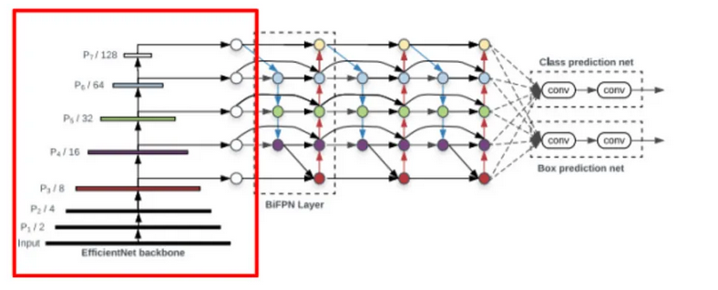

Slide 7
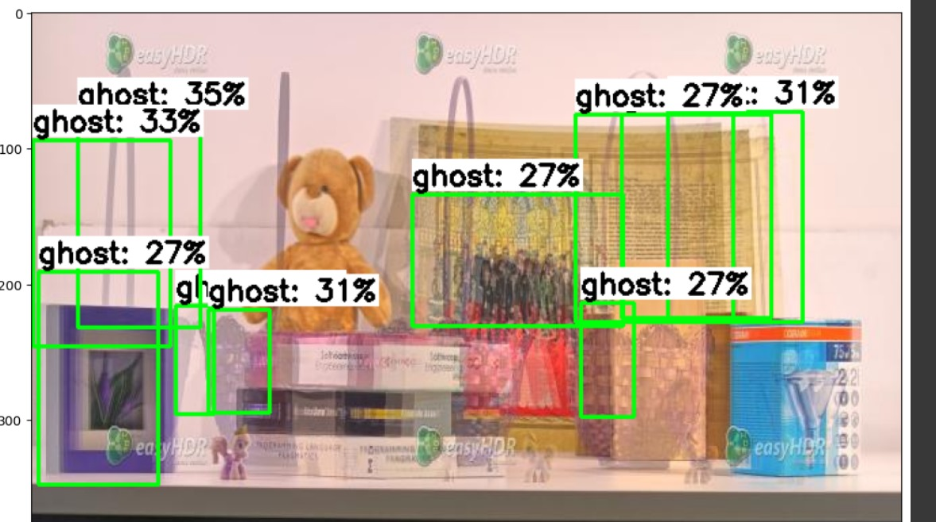
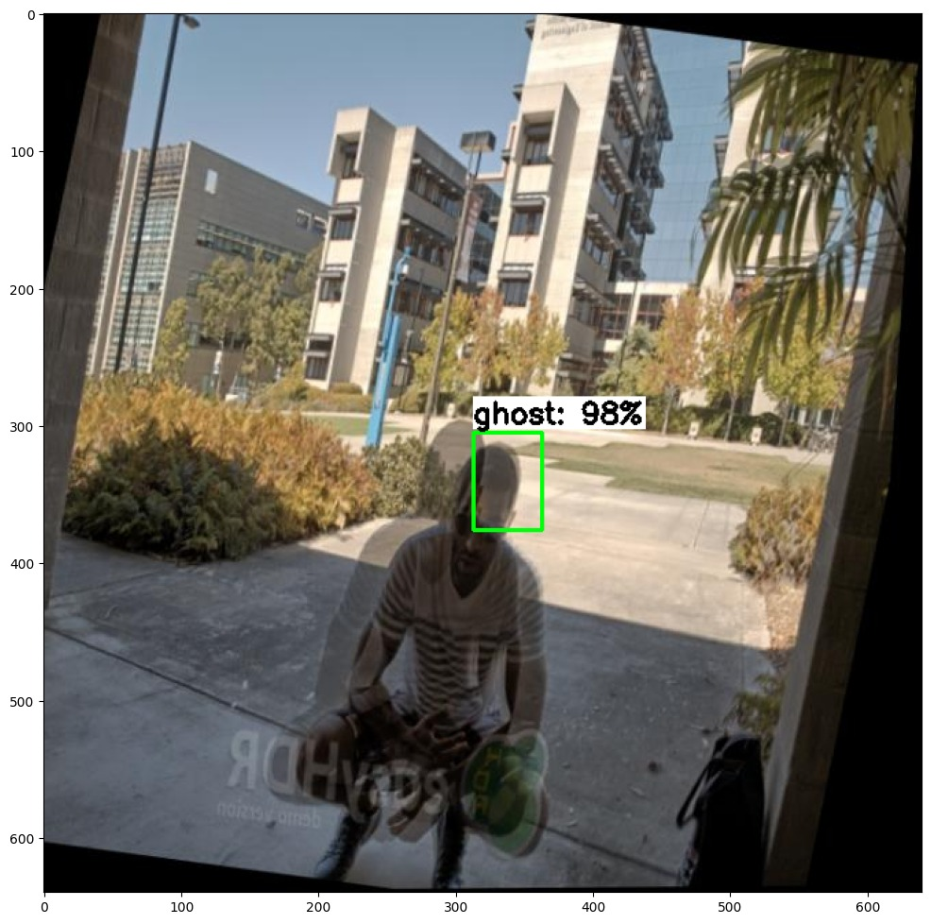
maP score-:3.47
Accuracy-:74%
Steps-:40000
Batch size-:4
Training images-:400

Slide 8
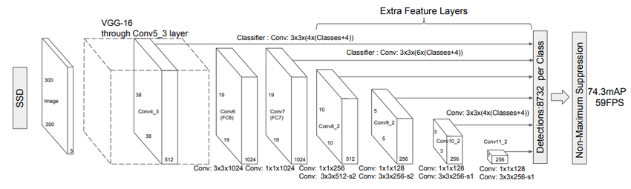
2.SSD-mobilenet-v2

Slide 9
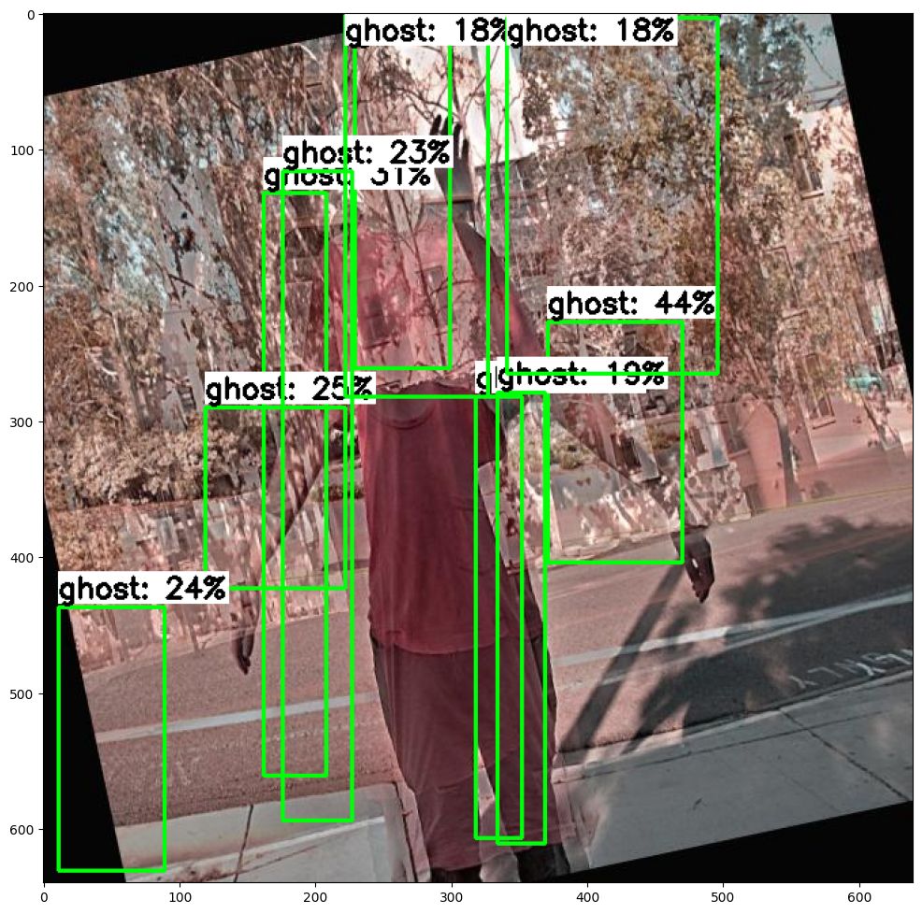
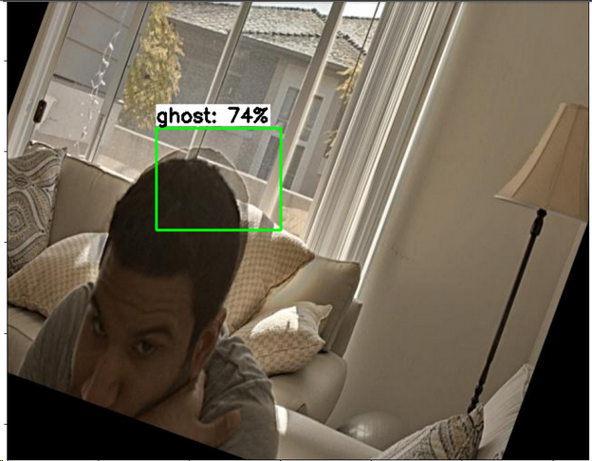
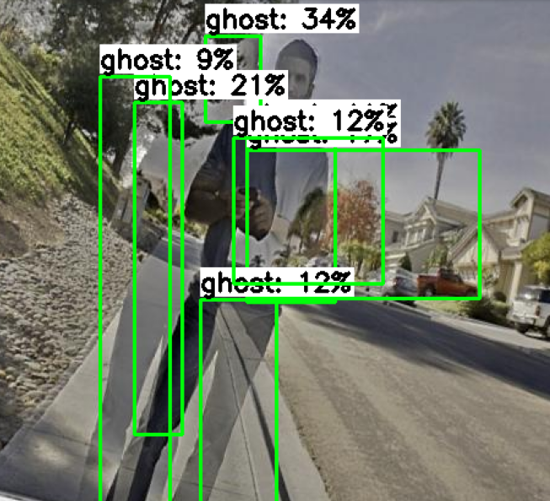
Number of steps-:25000 Batch size-:8 MAP score-:3 Accuacy-:93 Trained on-: 400 images

Slide 10
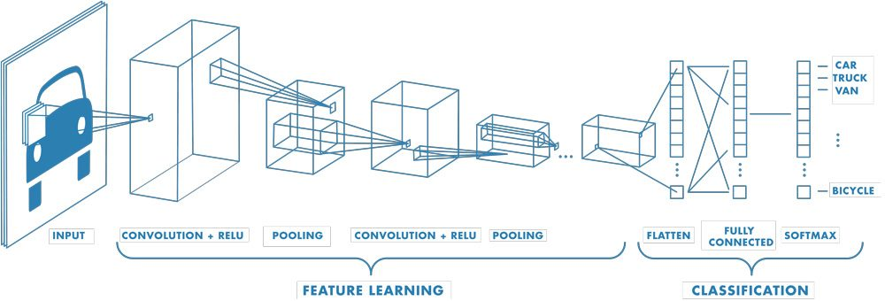
3.SSD Mobilenet FPNlite-320

Slide 11
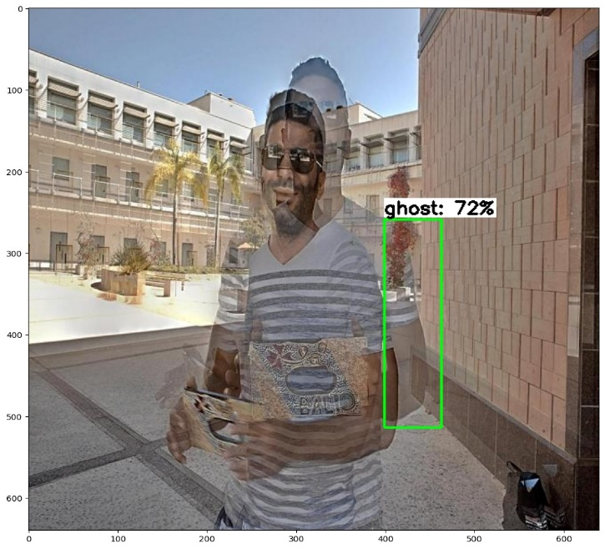
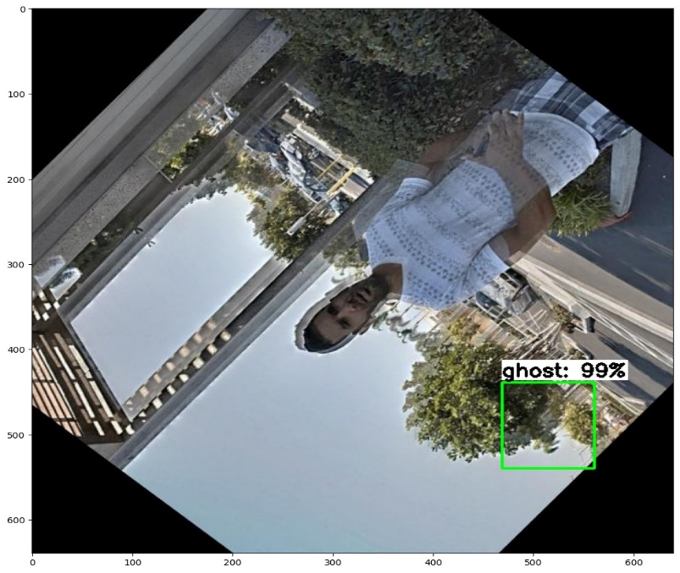
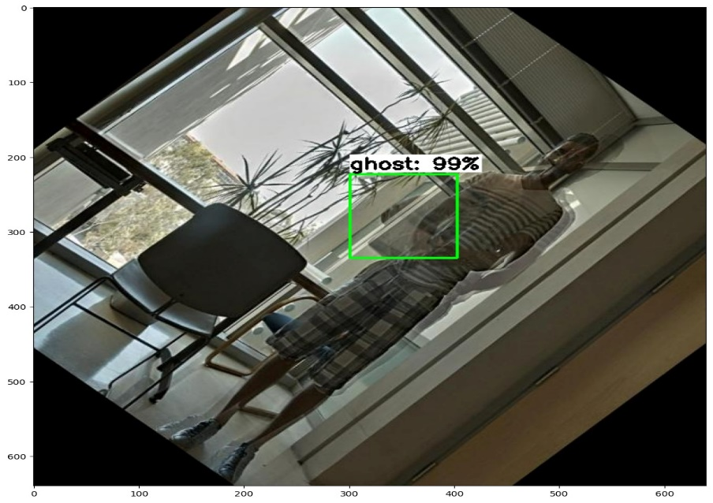
Results
mAP score:- 6
Accuracy:- 80
Number of steps:- 40000
Batch Size:- 8
Training Data:- 400 images

